Slide 1
AP Biology Review Semester I
Acids, Bases and pH
Polymers
Protein structure
Enzyme function
Protein hydrophilic/hydrophobic interaction

Slide 2
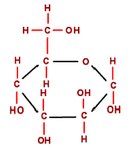
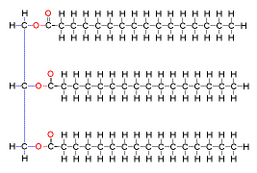
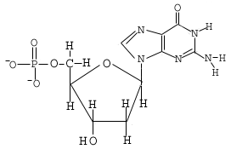
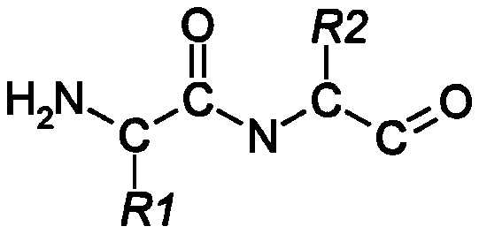
Macromolecules

Slide 3
Cell Structure

Slide 4
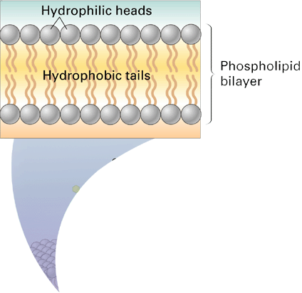
Membrane Structure
Phospholipid
Carbohydrate Chains
Cholesterol
Enzyme
Proteins

Slide 5
Cellular Transport:
Diffusion
Brownian Movement-
Osmosis/Water Potential
Active Transport
Phagocytosis

Slide 6
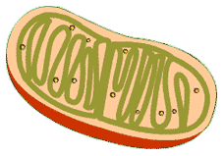
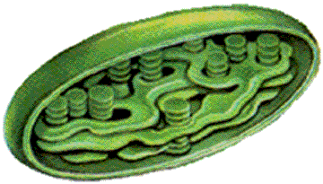
Cells and Energy
IN
Out
Respiration in the Mitochondrion
Glucose
Carbon Dioxide
Oxygen
Water
ADP
ATP
Free Phosphate(P_{i})
Photosynthesis in the Chloroplast
Glucose
Carbon Dioxide
Oxygen
Water
Water
Light Energy

Slide 7
How ATP works
ATP links Anabolism (building molecules) and catabolism (breaking down molecules)!!!!!
Catabolism
ATP is formed from ADP and P_{i} when energy is released by breaking the bonds of fuel molecules during cellular respiration
Anabolism
When ATP is broken down forming ADP and P_{i} energy is released to build molecules such as proteins

Slide 8
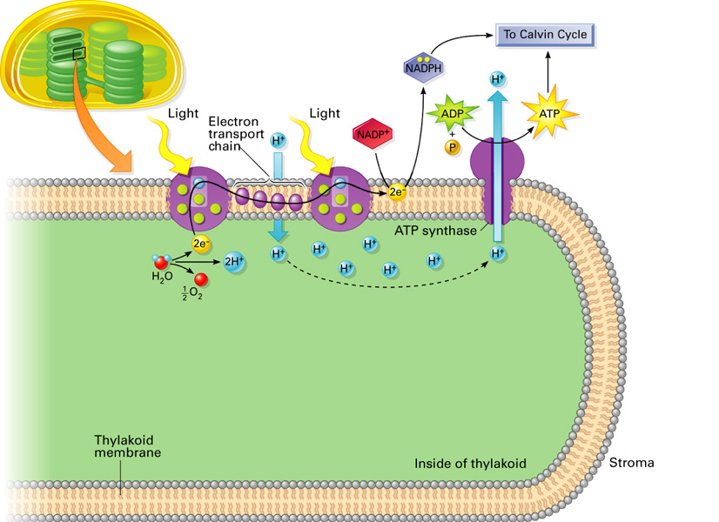
Light boost the electron to a NADP forming NADPH
Hydrogen ions flow through ATPsyntase forming ATP from ADP
A photon of light strikes chlorophyll and a water molecule is split
As electrons move down the electron transport chain, hydrogen ions are pumped into thylkoid

Slide 9
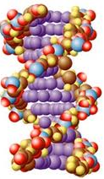
Mitosis/Meiosis/Genetics
Mitosis
Meiosis
Inheritance/Chi Square
DNA Structure
DNA Replication
Transcription
Translation

Slide 10
What is a Transformation?
Cell Wall
Cytoplasm
DNA
Plasmid DNA
E. coli
Plasmid DNA
Cell Membrane
This cell is NOT transformed
This cell is transformed
Answer: DNA is taken into a host cell

Slide 11
A Bacterial Lifecycle
Stabilization
Death
Population size
Log phase
Lag phase
Before 24 hours
After 24 hours
Time
Not Competent Cells
Competent Cells

Slide 12
What Happens During the 1st Incubation?
+Ca+
+Ca+
+Ca+
P
-
+Ca+
+Ca+
+Ca+
+Ca+
E.coli becomes metabolically inactive
Calcium ion neutralize phospholipid bilayer

Slide 13
What Happens During the 2nd Incubation?
Hopefully the plasmid DNA is pulled close to the zones of adhesion
Zones of Adhesion
Ca+2
Ca+2
Ca+2
Ca+2

Slide 14
What Happens During the Heat Shock?
Heat expands zones of adhesion and brings cytoplasm into contact with the plasmid!
Rapid cooling contracts zones and the cytoplasm sucks plasmid into the cell!!!

Slide 15
When bacteria are spread on a plate, three outcomes are possible:
If the cells are unable to grow, the plate will appear clear. This is called…..
If some cells cannot grow and others can grow, they form……
If all the cells grow, they will form a mass called a……
No growth
Colonies
Lawn

Slide 16
Biotechnology
Gel Electrophoresis
PCR

Slide 17
Evolution
Evidence
Natural Selection
Hardy-Weinburg

